Slide 1

Slide 1
Investment with Lending Club
Strategies for investors
Aesha Shah

Slide 2
Goal
Our goal is to help the investor make an informed decision about which loans they should invest in.
Data Provided
We have 2 years (2016-17) of Lending Club (LC) loan files which has data on loans that LC has issued.

Slide 3
Approach
My approach towards this challenge involves these steps –
Descriptive Analysis using Tableau to help provide an overall picture about the historic data which includes loan statistics, borrower metadata and the loan status.
Identify important attributes using inferences from the visualizations.
Next Steps (for a data scientist) -
Use these attributes to build a predictive model using machine learning algorithms (Example: Multiple Regression) in Python.
This model will take ‘Amount to be invested’ as the input and provide a list of loans for the investor to allocate funds in order to maximize returns.

Slide 4
Pre-Processing / Data Transformation
These are the transformations that I performed on the data using Tableau –
Split sub_grade to identify grade (Example – Extracted A from A1)
emp_length – Converted to numeric field with values 0-10 as suggested in the Data Dictionary.
issue_d – Split into 2 columns i.e. Month and Year (Example – Mar-16 to Mar & 2016 and assigned it the ’Date’ datatype)

Slide 5
Funded Amount based on Month, Year
Inference: Gradual increase in the Joint Application type of Loans from 2016 to 2017

Slide 6
Funded Amount based on Geography of borrower
Inference: States like California, Texas and New York have a higher loan amount concentration

Slide 7
Funded Amount based on length of Employment & Home Ownership
Inference: Higher loan amounts are requested by borrowers with 10+ years of employment & Mortgaged home ownership.

Slide 8
Funded Amount based on Purpose of Loan
Inference: High amounts of loan are borrowed for the purpose of Debt Consolidation

Slide 9
Count of Lending Club IDs based on Loan Status split by Month, Year
Inference: Majority of loans are either in the Current, Fully Paid or Charged Off stage

Slide 10
Count of Lending Club IDs based on FICO Score
Inference: Lower the FICO score, higher the count of borrowers and vice versa

Slide 11
Count of Lending Club IDs based on FICO Score and Loan Status
Inference: Lower the FICO score, high count of loans are in Current, Fully Paid & Charged Off stage with the counts inversely proportional to the FICO score

Slide 12
Funded Amount vs Count of Lending Club IDs based on Grade
Low Count
Low Risk
High Count
Low Risk
Low Count
High Risk
High Count
High Risk
Inference: Grades C, B & A are high in counts as well as high in loan amounts which makes them a safe investment and hence would provide lower returns; Grades D, E, F & G are in the low count and low amount quadrant which makes them a risky investment and hence an opportunity to earn higher returns.

Slide 13
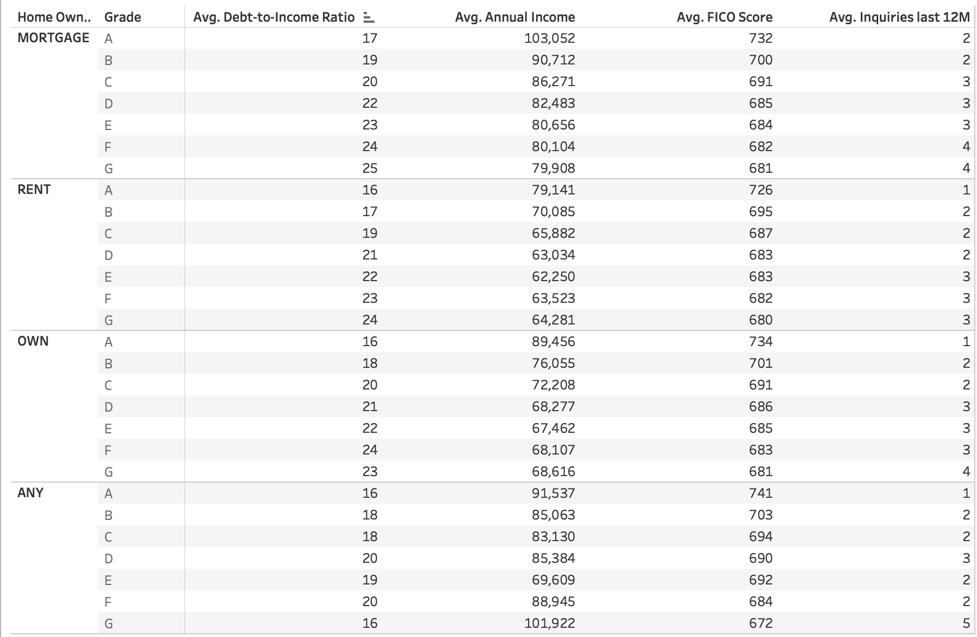
Borrower Metadata

Slide 14
Conclusion
These visualizations can provide a comprehensive picture about the borrower & loan statistics.
Investors can use these inferences and to make a calculated decision for allocating their funds in particular loans.
Some of the important factors that I feel would be important based on my analysis are –
Grade
Employment Length
Home Ownership
FICO score
Inquiries in last 12 months
Debt-to-Income Ratio
Annual Income
These factors should prove to be influential while building the machine learning model and give accurate results.

Slide 15

Slide 11
THANK YOU

